Slide 1
R Session 8
Infectious disease modelling and approaches to genetic analysis

Slide 2
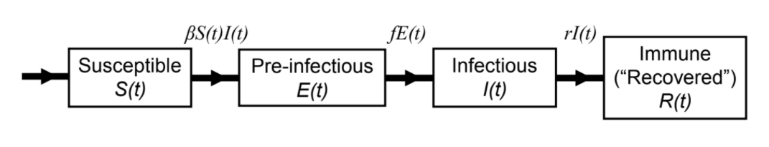



Background to ID Modelling
SEIR Model
Beta is the “per capita rate at which two specific individuals come into effective contact per unit time”.
How does this relate to the ‘R value’ we’ve all heard about?
Assume D is the infectious period in days
Rearrange these to get the R0

Slide 3
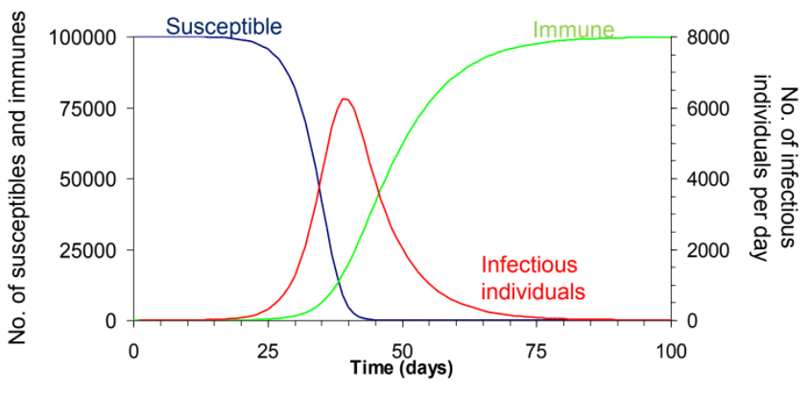
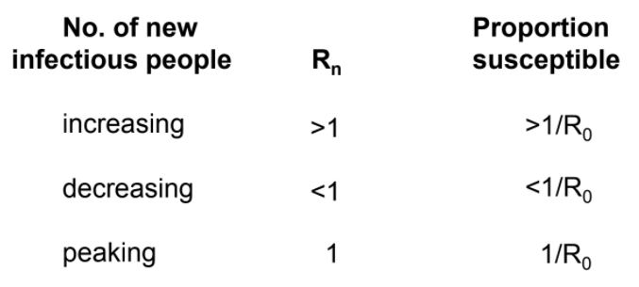
Let’s look at a single outbreak
Rn (changing R value) is equal to R0*proportion_susceptible

Slide 4
What’s happening
Number of new infectious individuals increases as there are sufficient numbers of susceptibles for Rn to be greater than 1
Proportion of susceptible people decreases
Once the proportion is sufficiently low, the Rn drops to below one and the number of new infectious individuals starts to decrease.
Depending on the timeframe being examined new births of susceptibles may have to be modelled in to the population as these fuel continued infections

Slide 5
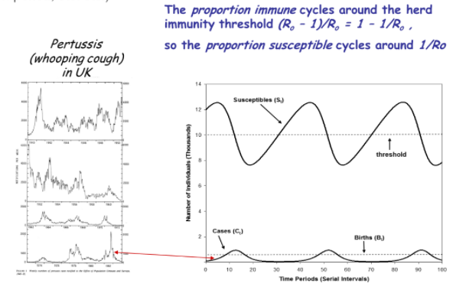
Visually

Slide 6
Let’s try and code one of these simple models
Load in the package epimodel
Copy and paste the model code and we’ll go through the flows

Slide 7
Further Model Developments
Next Generation Matrices for different beta values of social groups/age groups mixing, and their individual R values
Monte Carlo simulation for stochastic iteration of models
Running the same thing lots of times with different parameters chosen from a distribution to see where the overall distribution of predictions are
Machine learning applications
Effect of public health interventions on transmission

Slide 8
Infectious Disease Eradication
Epidemiological
1. Absence of non-human reservoir
2. Ease of recognition / diagnosis
3. Durability of immunity post infection / vaccination
4. Low transmissibility
Practical feasibility
5. Availability of effective and practical intervention
6. Evidence of local / regional success
Political + popular support
7. Perceived burden > estimated cost of eradication
8. Implications for other interventions
9. Political will

Slide 9
Herd Immunity – difficult questions
We’ve heard this talked about a lot with COVID, but the definition comes from modelling the spread of an infectious disease
Once a disease is endemic in a population and no longer growing the R0 = Rn/prop_susceptible with the Rn being about 1
Therefore to stop spread of a disease prop_susceptible has to be less than 1/r0, and the prop_vaccinated needs to be 1-1/R0
You have to also consider natural immunity from disease recovery, and the % of that which are actually lifelong immune
And also vaccine efficacy, not just protecting against disease development but also against infectiousness/asymptomatic spreading and infection itself (these aren’t always the same)

Slide 10
How to evaluate vaccines
Studies mostly (cohort, case control, best is RCT), but be careful
If there is high uptake then there is something unusual about unvaccinated ppl
Ascertainment of cases of adverse effect/disease MUST be independent of vaccine history (autism anyone…?)
Vaccination data has to be based on documented evidence rather than Hx
Unwell children may have some vaccinations contraindicated, and therefore may make the vaccine appear protective of some adverse effect
There are as many confounders as you can think of, and many ulterior motives to discredit vaccination.
As the memory of the disease target declines the importance of adverse effects increases

Slide 11
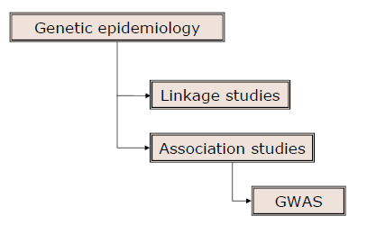
Genetic Epidemiology
Genome wide association studies are the new hot ticket to a quick publication
Balding(2006) gives a great easy to understand introduction to properly using statistical methodology to approach single SNP (single nucleotide polymorphism) analysis and beyond

Slide 12
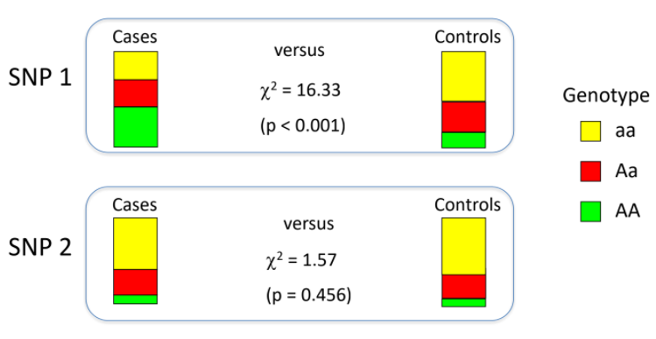
Association Studies
High number of variants assayed  errors and genotype or sequence miscalls are bound to happen
If problematic samples not identified and excluded, they can affect the results of the entire experiment
If SNPs with erroneous genotyping or sequencing not identified and excluded, can produce false signals of associations
Therefore perform quality control (QC) procedures on samples and SNPs
Basic principle: use samples and SNPs of high quality

Slide 13
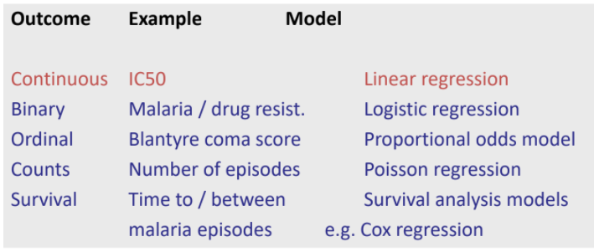
Genetic analysis in R
TOO MANY PACKAGES
genetics, haplo.stats (haplo.ccs, hapassoc), gap, identity, pedigree, hwde, multic, LDheatmap.
SNPassoc, snpMatrix, GenABEL, pbatR, statgenGWAS
In the end though you can still use conventional analysis methods once you’ve got your hypothesis

Slide 14
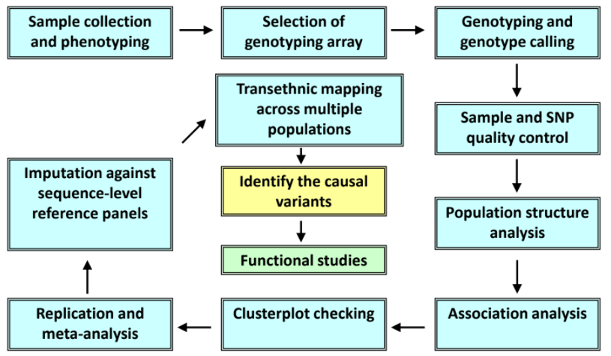
GWAS Pipeline Example

Slide 15
Github
First make a github account and download github desktop and git itself
What is github?
It’s where the world’s code is stored
It allows multiple people to share and collaborate on code and different parts of a larger project
It’s also where your code portfolio is kept for other people to look at and share.
What’s a git then? – a version control system for branching changes.
Git is to Github as Porn is to Pornhub

Slide 16
How to set up a repo
If you’ve set up a github account just follow these steps
First make a repository on Github, call is something like R_Teaching, and initialise it with a README
Then set up a new project in RStudio
Use ‘Version Control’ and open in a new session
Use the URL of your new repo on
What you’ve made is a new folder, a git repo (linked to a Github repo), and an Rstudio project
Then just copy over all the relevant files for them to be synced

Slide 17
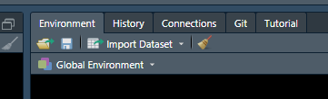
Commitment
There’s a new pane in the global environment
Your code/files should be showing up there with question marks, meaning they are new untracked files.
Stage them (set the stage for version tracking) and then commit them
You have to have a message in the commit, make it something fun.

Slide 18
PUSH
It’ll then say how far ahead of the common repo your versions and commits are
Push them to merge with the common thread of the repo
That’s it
Now your code is up in the GitHub and you can work on it from wherever you want.
It’s like google drive, but every past change is saved and every change has to be approved and committed with some commenting

Slide 19
Q+A?

